Slide 1

Custom Bootcamp
Week 5 (Sep 18 - Sep 22)
Pagidala Saketh Reddy
Employee code: 655074
Unext ID: SH7B23136

Slide 2

Agenda
Sep 18th – Holiday
Sep 19th – Python Session 2
Sep 20th – Python Session 3
Sep 21st – PySpark Session 1
Sep 22nd – PySpark Session 2

Slide 3
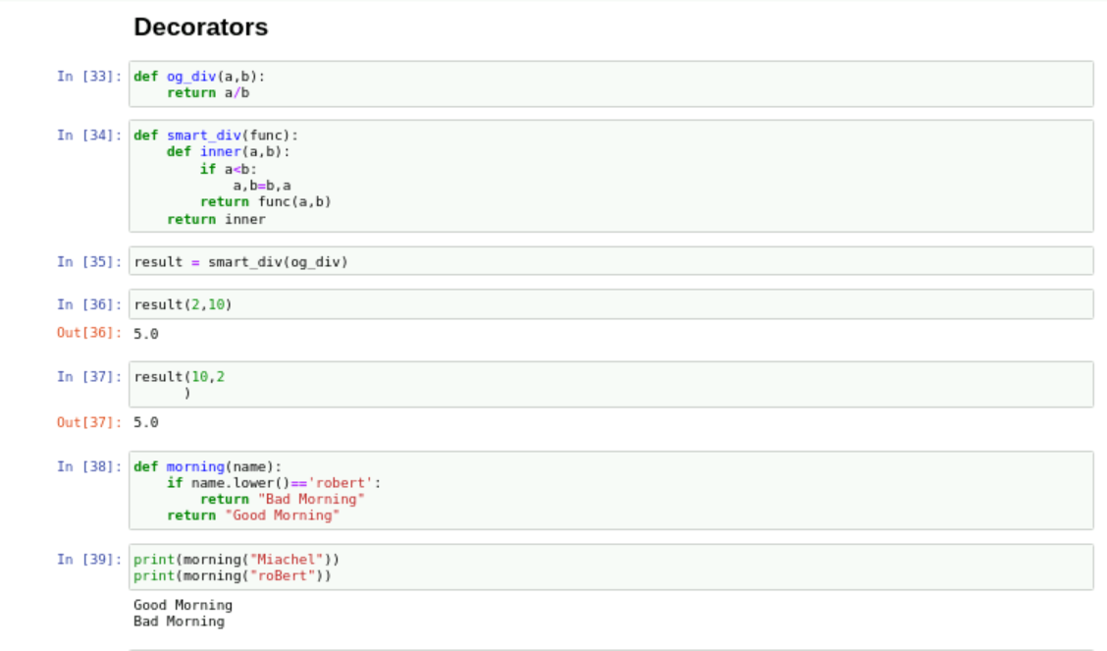
Python Session 2
Topics
Functions and Parameters
Arguments and Keyword Arguments
Decorators
Lists
Yield
Lambda functions

Slide 4
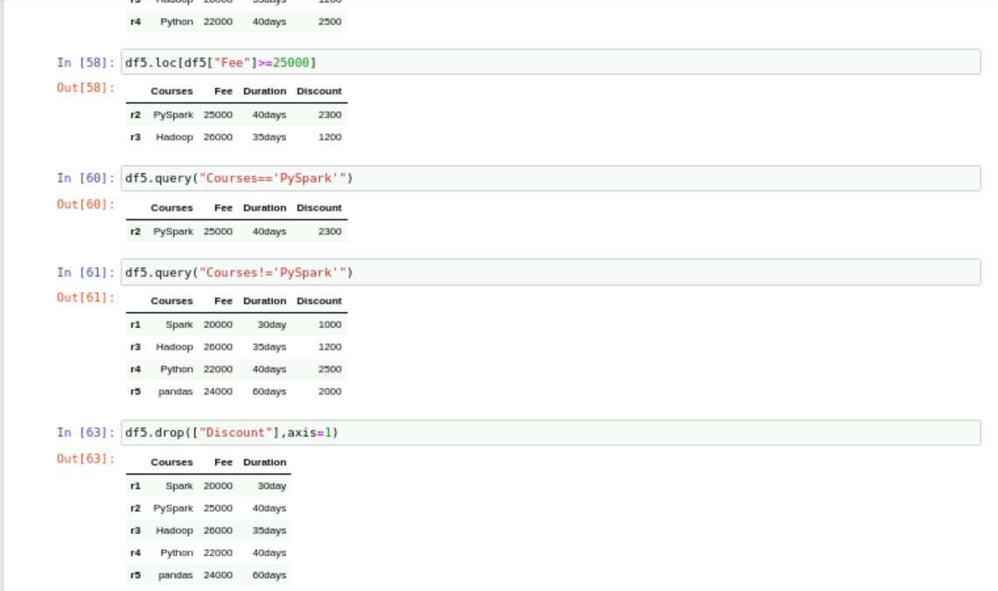
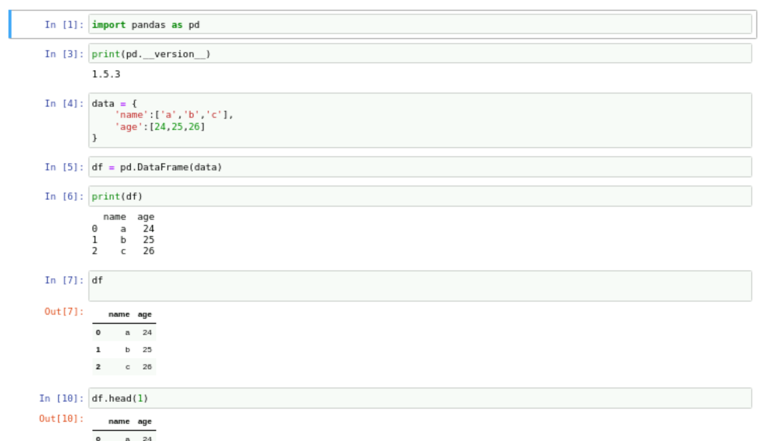
Python Session 3
Topics
Pandas and Numpy
Data Frames
Usage of Functions like loc, query, drop, shapes etc
Classes and Objects

Slide 5
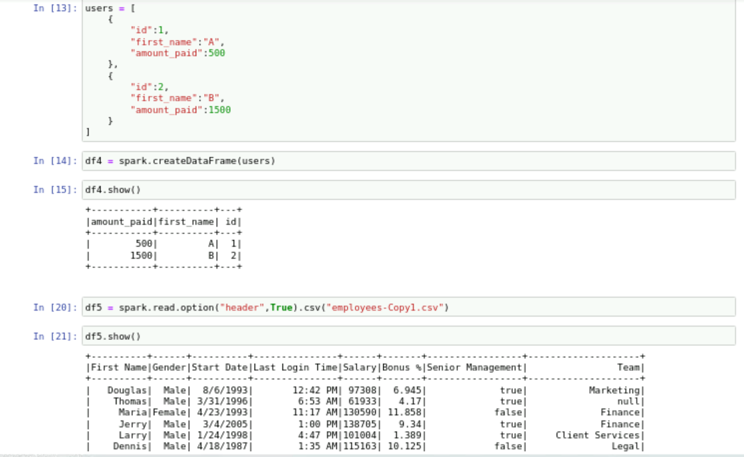
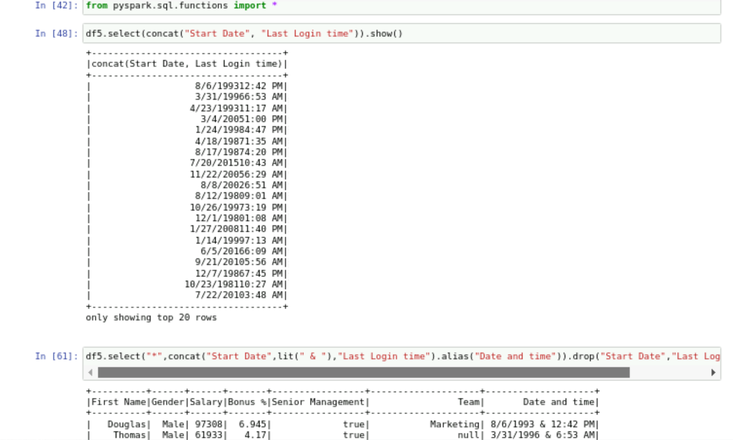
PySpark Session 1
Topics
PySpark Introduction
PySpark with Resilient Distributed Data frames (RDD)
Creating Data frames using spark sessions
Manipulating the created data frames

Slide 6
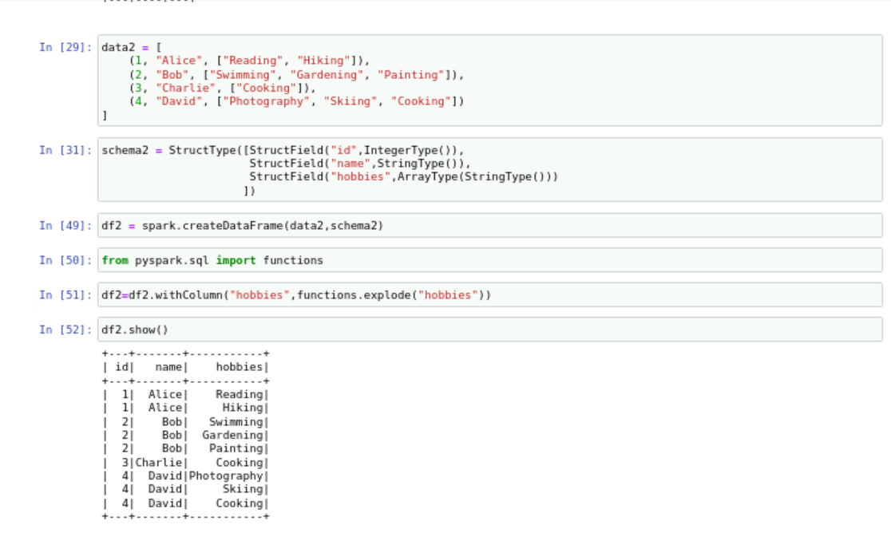
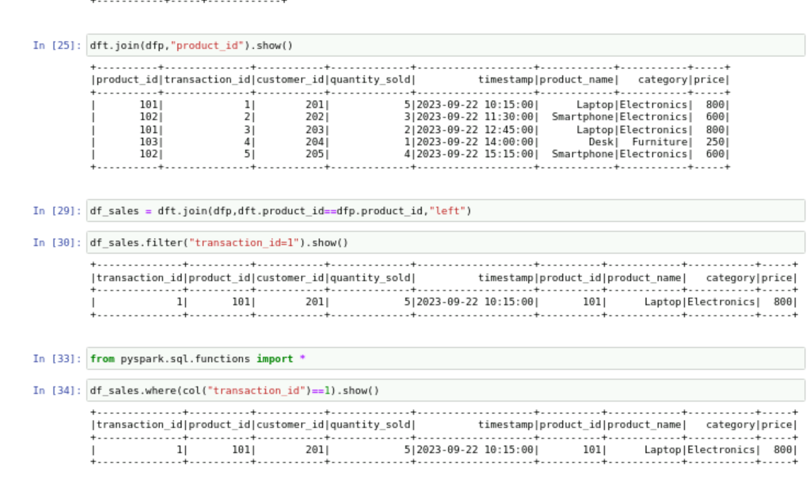
PySpark Session 2
Topics
PySpark data types and schemas
Sorting and Grouping Data frames
Creating Data frames of file types such as JSON, CSV and Parquet
SQL functions in pyspark
Joining Data frames

Slide 7

Thank You

